Slide 1

x⁰
d⁰
x⁰
d⁰
u
x
u
x
y
v
y
d
v
d
k
x ⁰
d ⁰
k
u^{t}
y ^{t}
k, $η, θ$
v ^{t}
x ^{t}
d ^{t}

Slide 2
m× n matrix: n columns, each containing m rows
column j
contains
m
neurons
. . . . . . . . . .
(n-1)m
+1
1
m+1
2m+1
2
m+2
2m+2
. . . . . . . . . .
(n-1)m
+2
...
...
...
...
row i
(j-1)m
+i
m
2m
3m
. . . . . . . . . .
nm
u₁^{t}
u₂^{t}
u₃^{t}
u_{j}^{t}
u_{n}^{t}

Slide 3
m
m
m
m
m
m
m
m
m
m

Slide 4
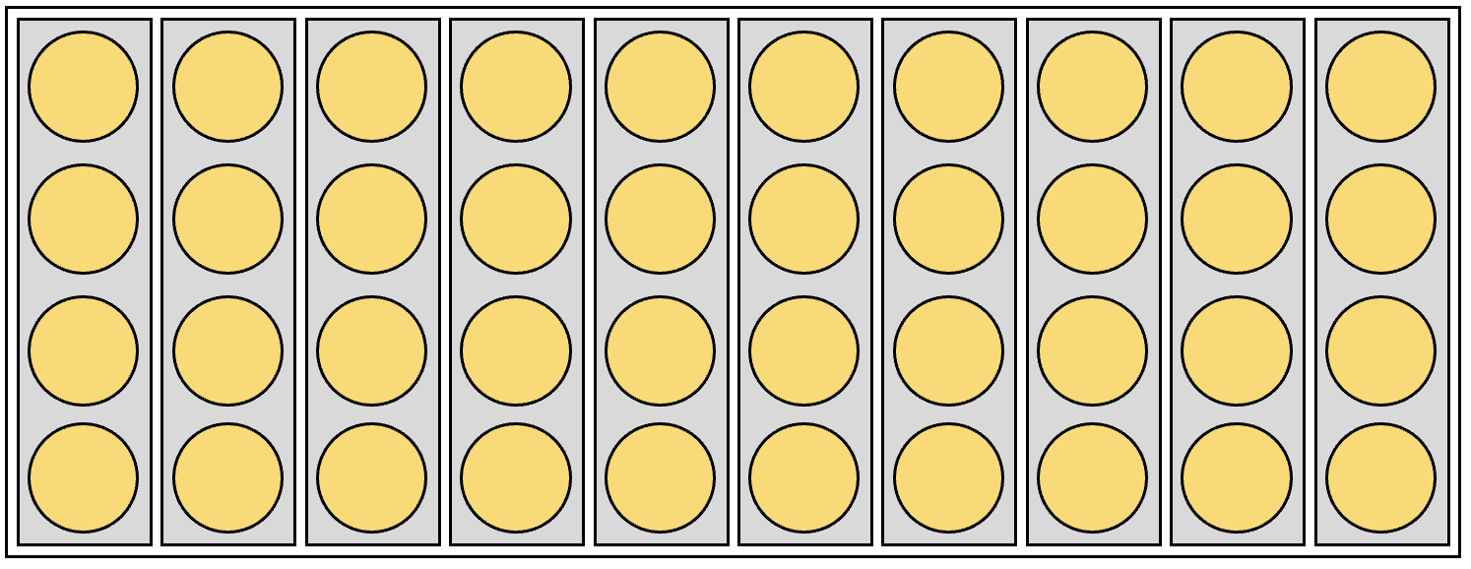
x ⁰
D ⁰
u^{t}
y ^{t}
v ^{t}
x ^{t}
D ^{t}

Slide 5
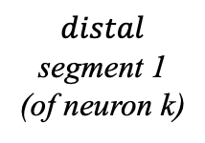
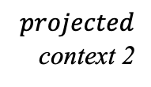


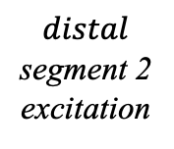
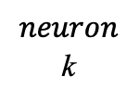
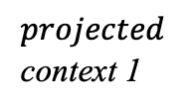
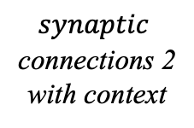
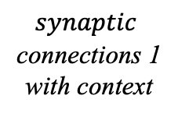
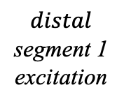

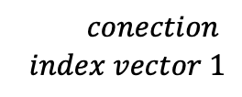


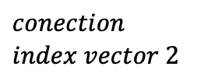


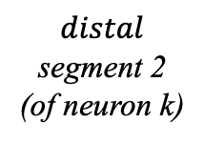

$$distal$$
segment 1
excitation
u_{k}
$$distal$$
segment 2
excitation
$$\left[{0 \atop \begin{aligned}1 \\ 1 \\ 0 \\ 1\end{aligned}}\right]$$
$$\left[{0 \atop \begin{aligned}1 \\ 1 \\ 0 \\ 0\end{aligned}}\right]$$
$$\left[{0 \atop \begin{aligned}0 \\ 1 \\ 0 \\ 0\end{aligned}}\right]$$
$$\left[{0 \atop \begin{aligned}1 \\ 1 \\ 0 \\ 1\end{aligned}}\right]$$
$$synaptic$$
connections 1
with context
q_{k2} =
$$synaptic$$
connections 2
with context
s_{k1} =
q_{k1} =
s_{k2} =
2
1
2
y₂ = 0
0.1
$$θ$$
0.2
y₃ = 1
3
v = y
5
y₅ = 1
0.5
0.8
y₄ = 0
4
v = y
$$neuron$$
k
7
y₇ = 1
0.8
$$2≥θ$$
0.7
y₇ = 1
7
$$context$$
$$context$$
8
y₈ = 1
0.3
0.3
y₉ = 1
9
11
y₁₁= 0
0.7
0.9
y₁₀ = 0
10
k_{k1}
z_{k1}
d_{k1}
y_{k}
d_{k2}
z_{k2}
k_{k2}
$$conection$$
$$index vector 1$$
$$projected$$
context 1
$$distal$$
segment 1
(of neuron k)
$$distal$$
segment 2
(of neuron k)
$$projected$$
context 2
$$conection$$
$$index vector 2$$

